Slide 1
Software Concepts
System | Description | Main Goal
DOS | Tightly-coupled operating system for multi-processors and homogeneous multi-computers. | Hide and manage hardware resources.
NOS | Loosely-coupled operating system for heterogeneous multi-computers. (LAN and WAN) | Offer local services to remote clients.
Middleware | Additional layer atop of NOS implementing general-purpose services. | Provide distribution transparency.

Slide 2
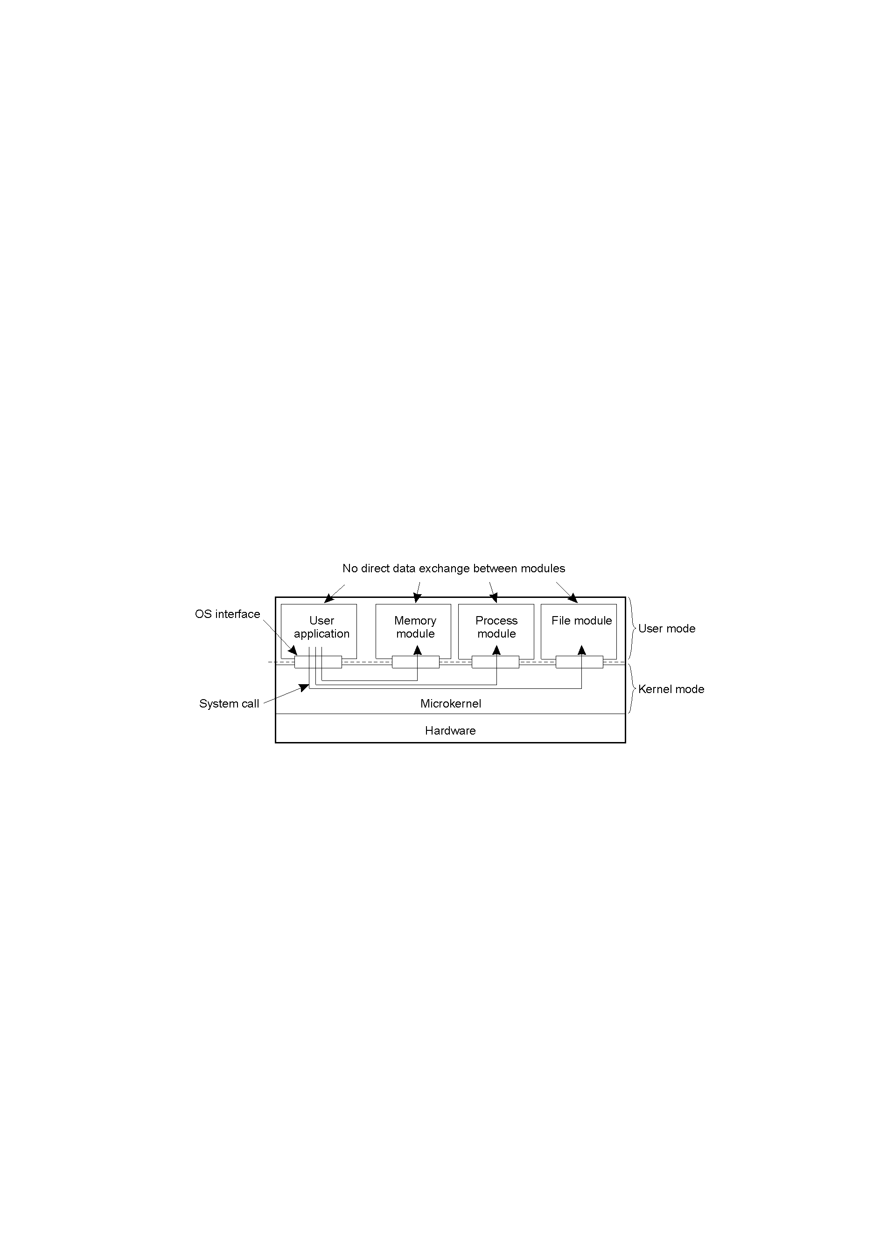
Uni-processor Operating Systems
Separating applications from operating system code through a microkernel

Slide 3
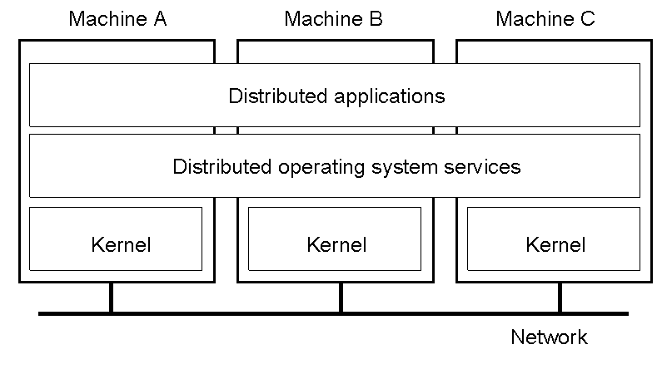
Multicomputer Operating Systems
But no longer have shared memory
  to provide distributed shared memory
  Can provide message passing

Slide 4
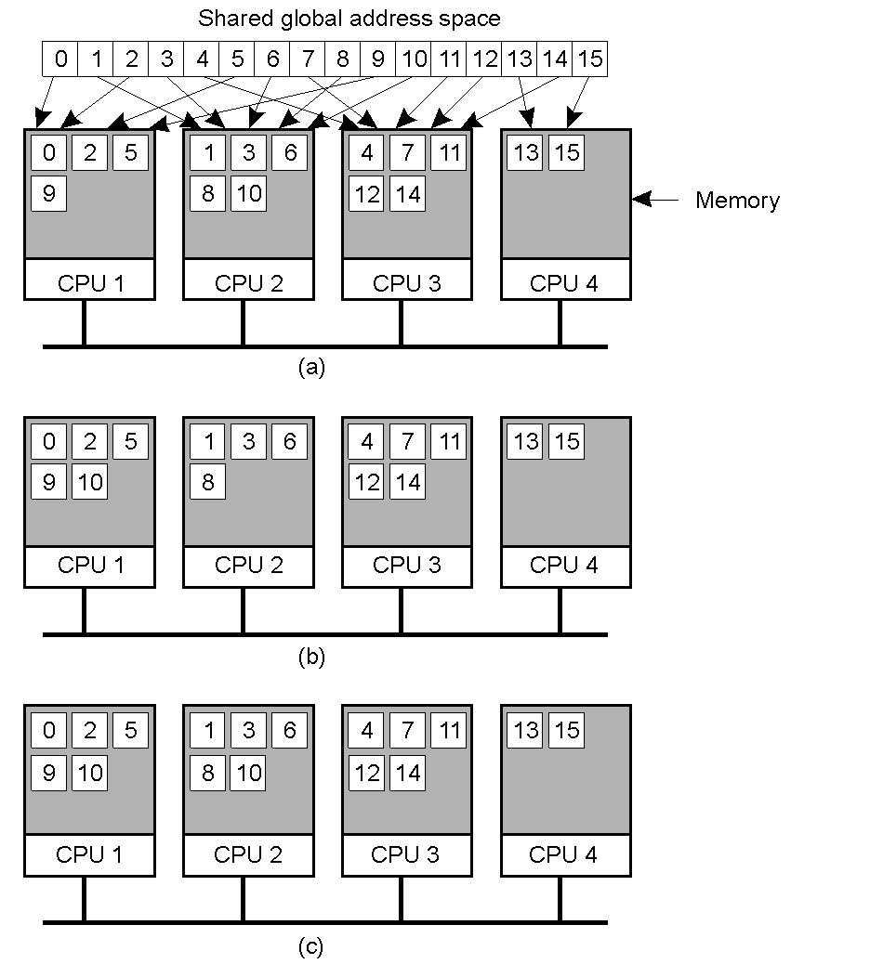
Distributed Shared Memory Systems
Pages of address space distributed among four machines.
Situation after CPU 1 references page 10.
Situation if page 10 is read only and replication is used.

Slide 5
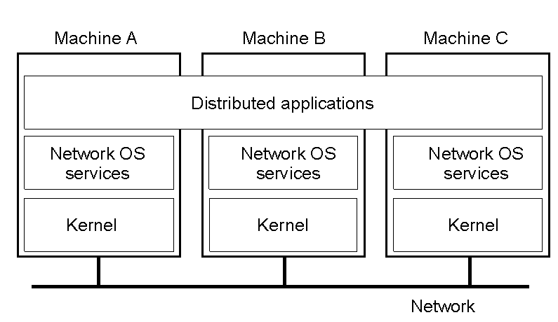
Network Operating System
OSes can be different (Windows or Linux)
Typical services: rlogin, rcp
  Fairly primitive way to share files

Slide 6
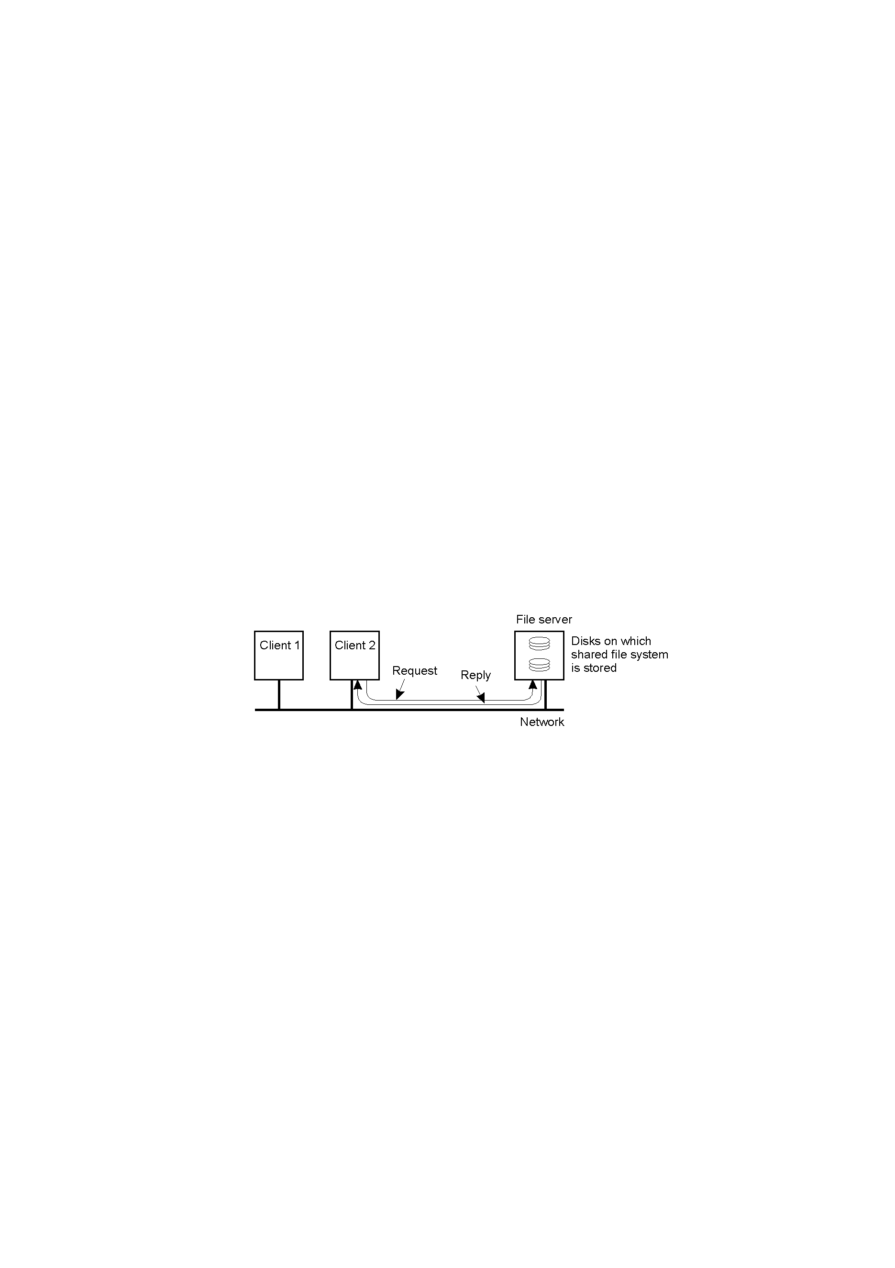
Network Operating System
Can have one computer provide files transparently for others (NFS)

Slide 7
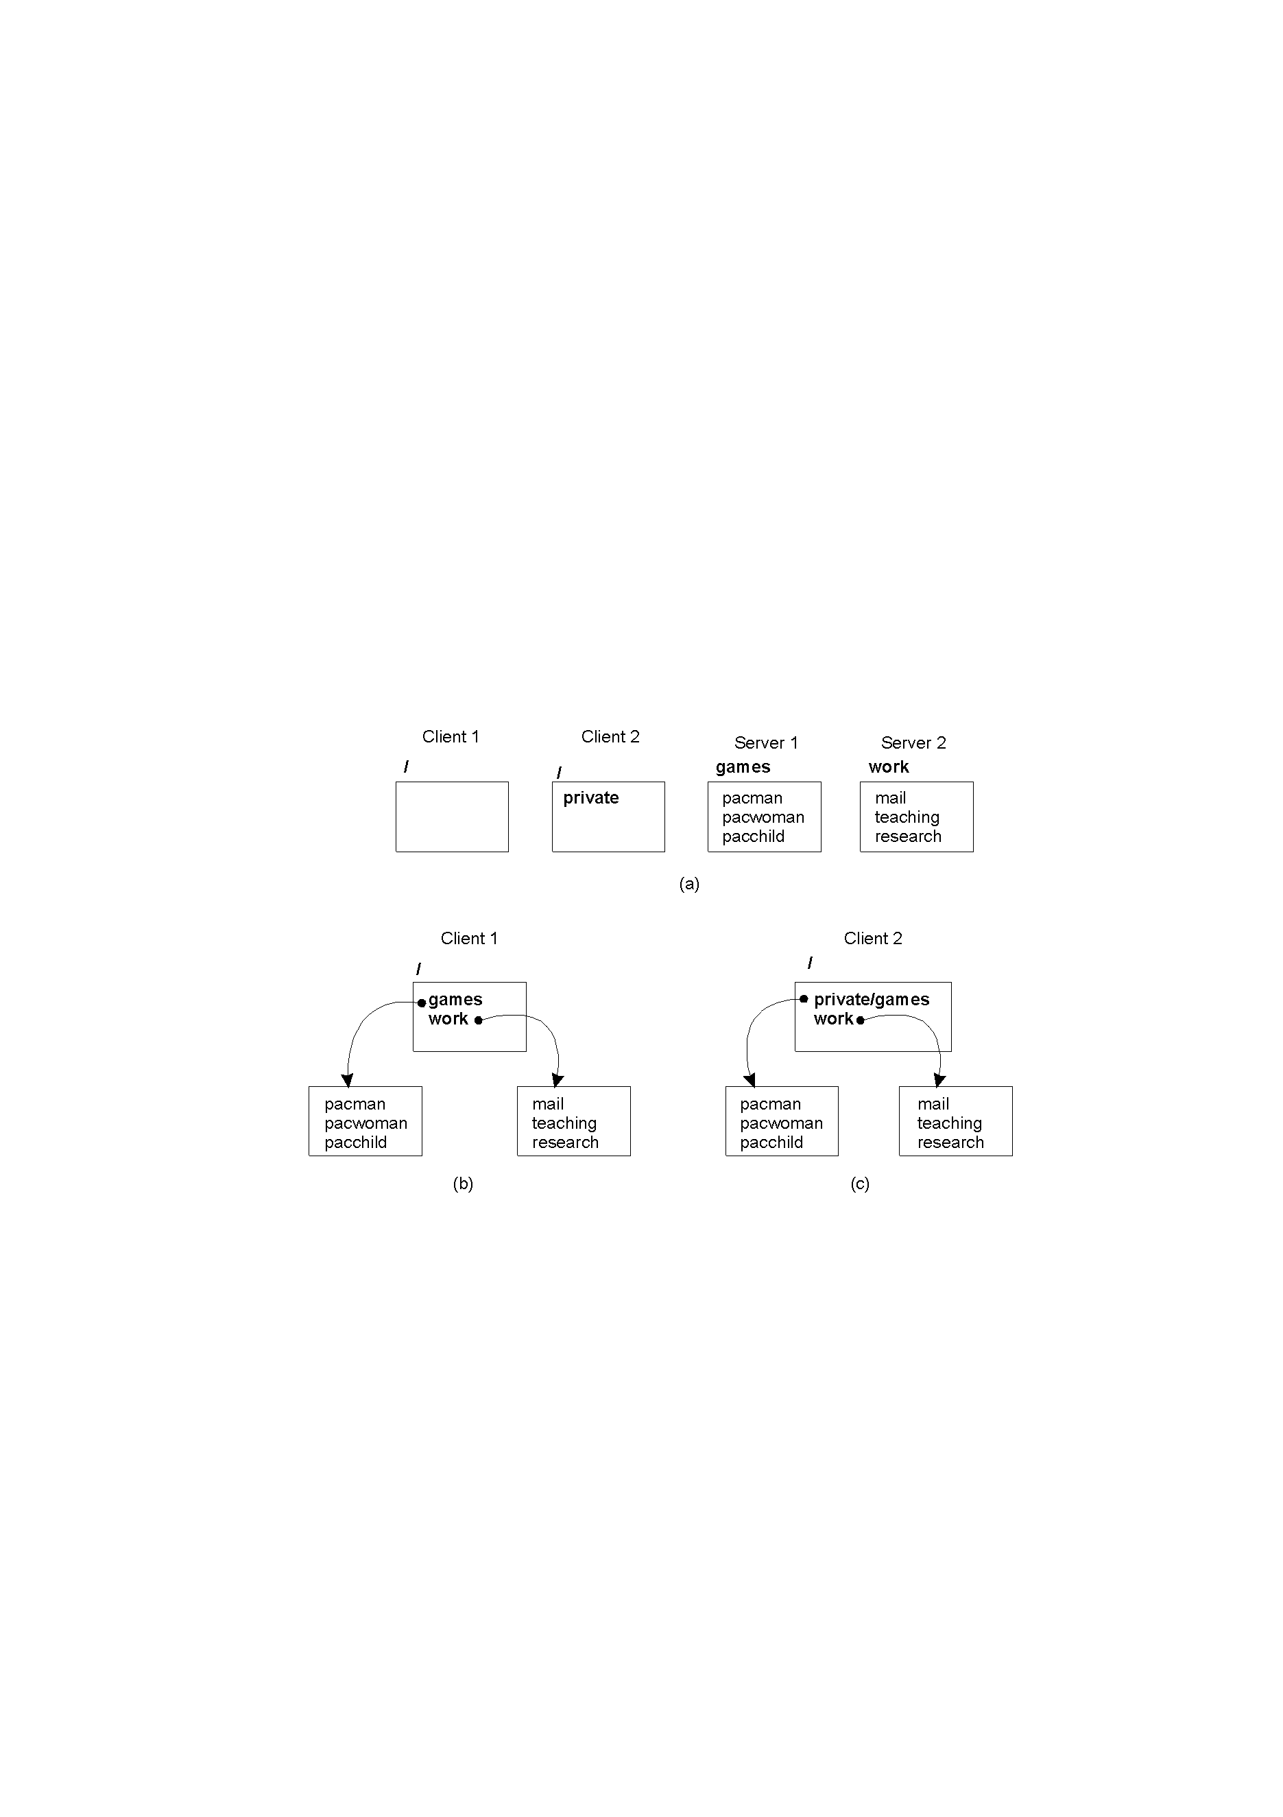
Network Operating System
Different clients may mount the servers in different places

Slide 8

Positioning Middleware
Network OS not transparent. Distributed OS not independent computers.
  Middleware can help
Much middleware built in-house to help use networked operating systems (distributed transactions, better comm, RPC)

Slide 9
Comparison between Systems
Item | Distributed OS |  | Network OS | Middleware-based OS
 | Multiproc. | Multicomp.
Degree of transparency | Very High | High | Low | High
Same OS on all nodes | Yes | Yes | No | No
Number of copies of OS | 1 | N | N | N
Basis for communication | Shared memory | Messages | Files | Model specific
Resource management | Global, central | Global, distributed | Per node | Per node
Scalability | No | Moderately | Yes | Varies
Openness | Closed | Closed | Open | Open
DOS most transparent, but closed and only moderately scalable.
NOS not so transparent, but open and scalable.
Middleware provides a bit more transparency than NOS.

